Slide 1

Modeling Wine Quality Using Physiochemical Properties
A Data Mining
Analysis By Clement Chen

Slide 2

The Problem
Wine quality is difficult to quantify
Human tasting is currently the main way of distinguishing wine quality
Inconsistent and prone to bias
Is it possible to accurately model
wine quality based on physiochemical
properties of the wine?

Slide 3
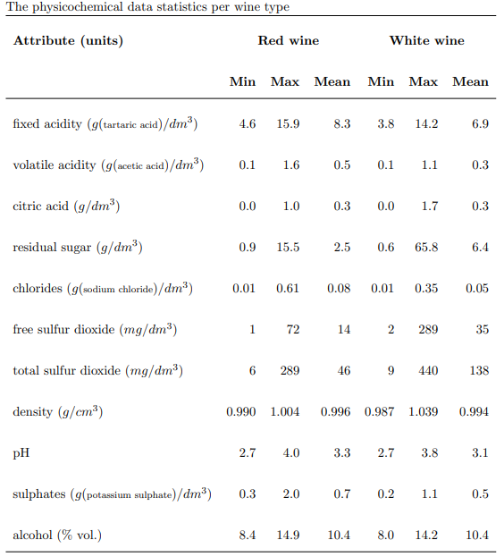
Data Information
• Source University of Minho, Viticulture Commission of the Vinho Verde region (CVRVV)
•Each row contains a wine sample
• Contains two data sets
• Red wine 1599 samples
• White wine 4898 samples
• 11 feature columns 1 class label column
• Class labels are a quality rating from 0-10 based off the median value of at least 3 wine experts
• CSV format

Slide 4
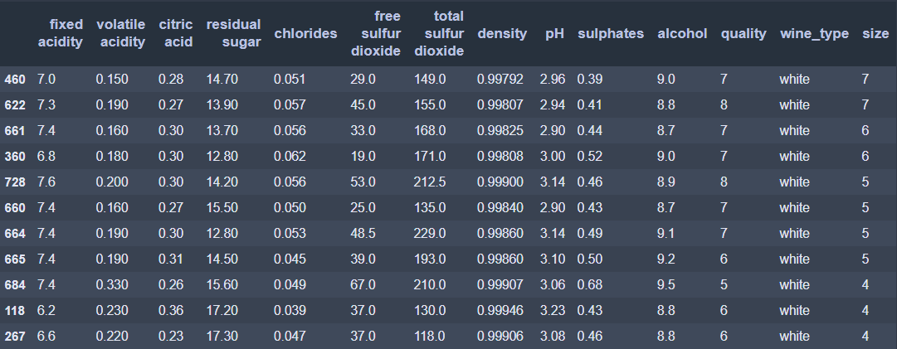
Data Wrangling
Data were very clean
Many duplicate rows
Based on the unlikely chance that feature values were coincidentally the same values, and metadata stating wine quality is the median value of at least 3 wine experts, we can conclude that these are true duplicates
Table of some of the duplicate values removed.
The ‘size’ column represents the number of the duplicate rows found.

Slide 5
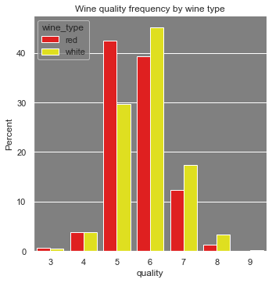
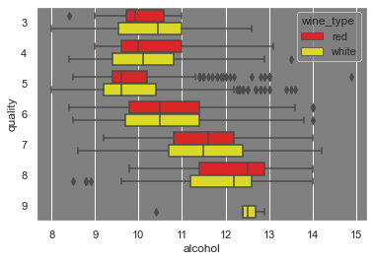
EDA
• White wines tend to have higher quality then red wines
• Most wines are in the 5-6 quality range
• Alcohol volume seems to be an important factor in determining wine quality for both red and white wines
• Higher alcohol content can be the result of • Higher sugar content from the grapes
• More sugar being turned into alcohol
• Length of fermentation

Slide 6
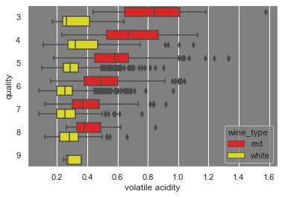
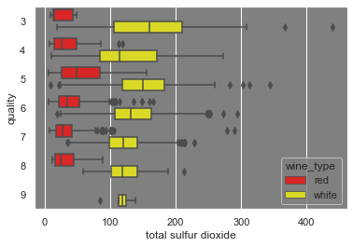
• Volatile acidity (acetic acid) is a significant indicator of quality in red wines
• Acetic acid content is the result of naturally occurring bacteria processing alcohol and oxygen into acetic acid
• Less total sulfur dioxide is an indicator for higher quality in white wines
• Sulfurs are added into wines for stability and to protect against oxidation but in this case, a tradeoff was made.

Slide 7
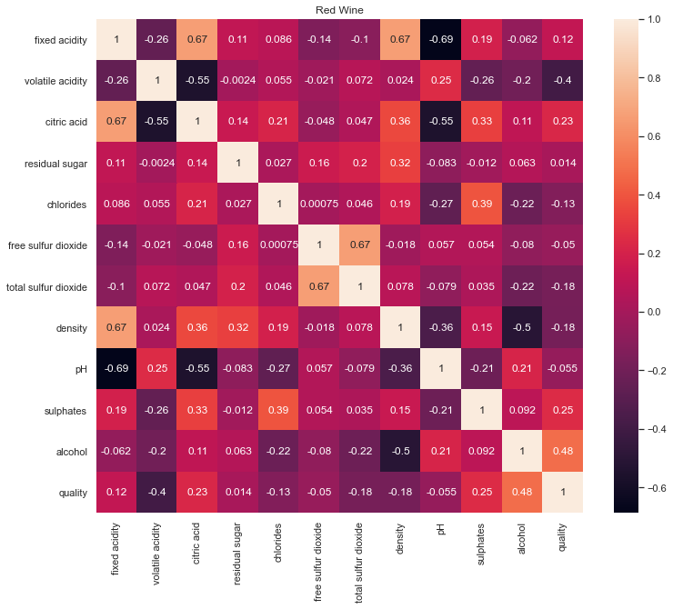
Red Wine Correlated Features
Feature 1 | Feature 2 | Correlation
Fixed Acidity | pH | -0.69
Fixed Acidity | Density | 0.67
Fixed Acidity | Citric Acid | 0.67
Total Sulfur Dioxide | Free Sulfur Dioxide | 0.67

Slide 8
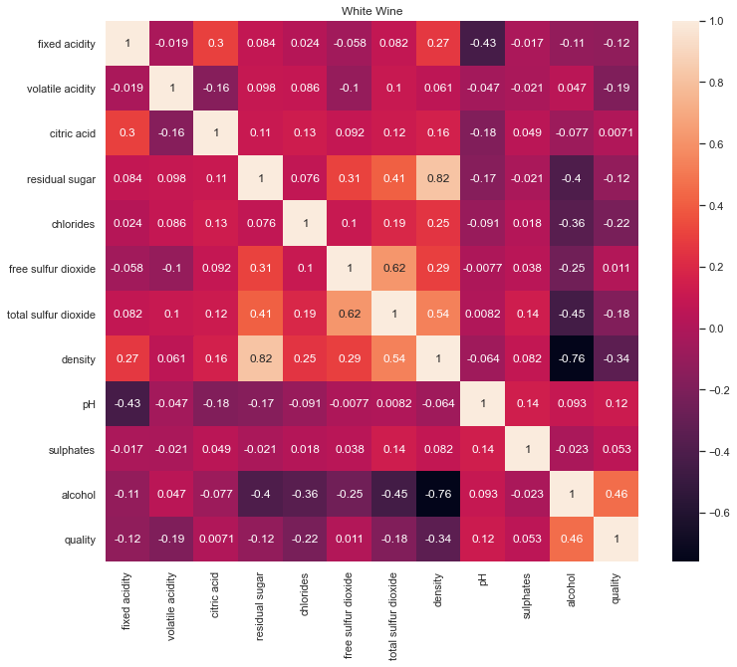
White Wine Correlated Features
Feature 1 | Feature 2 | Correlation
Residual Sugars | Density | 0.82
Density | Total Sulfur Dioxide | 0.67
Alcohol | Density | -0.76
Total Sulfur Dioxide | Free Sulfur Dioxide | 0.62

Slide 9
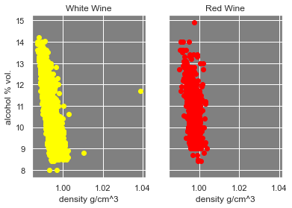
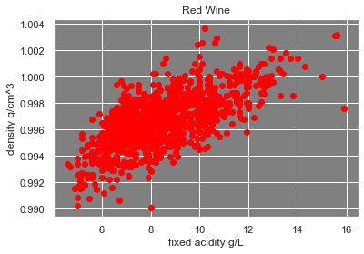
Some features appear to be highly correlated to each other. Depending on the machine learning algorithm used, multicollinearity could be an issue.

Slide 10
Preprocessing
Data Preprocessing:
1. Train-test split of ratio 80-20
2. Training data was fitted with RobustScaler
3. Test data was scaled with the fitted RobustScaler to prevent data leakage 4. Data was binned into low (0-6) and high (7-10) quality to create a binary classification task
Data
Transform
low
20
RobustScaler
80
Bin
Fit + transform
high

Slide 11
Modeling
Classification Algorithms Used
Gradient Boosted Tree Winner for Red Wine
Logistic Regression
Logistic Regression with PCA
Random Forest
Gradient Boosted Trees
Hyperparameter Tuning
5-fold CV with GridSearchCV and RandomizedSeachCV
Random Forest Winner for White Wine
Scoring
ROC_AUC was used for scoring models

Slide 12
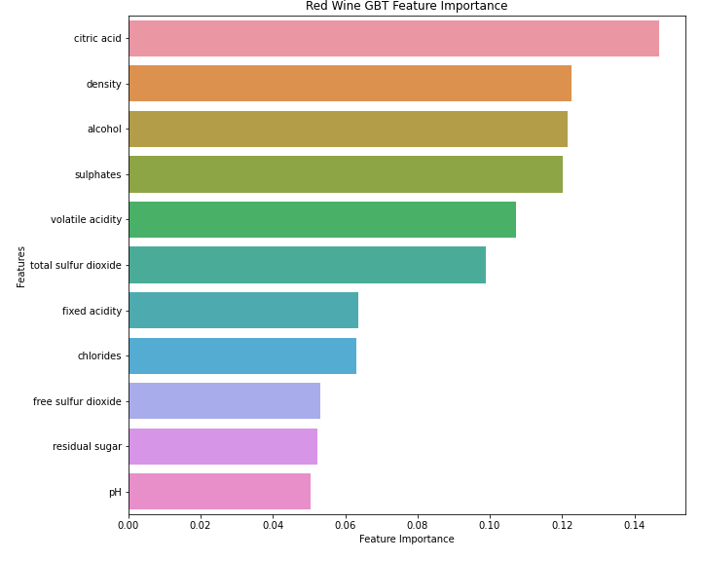
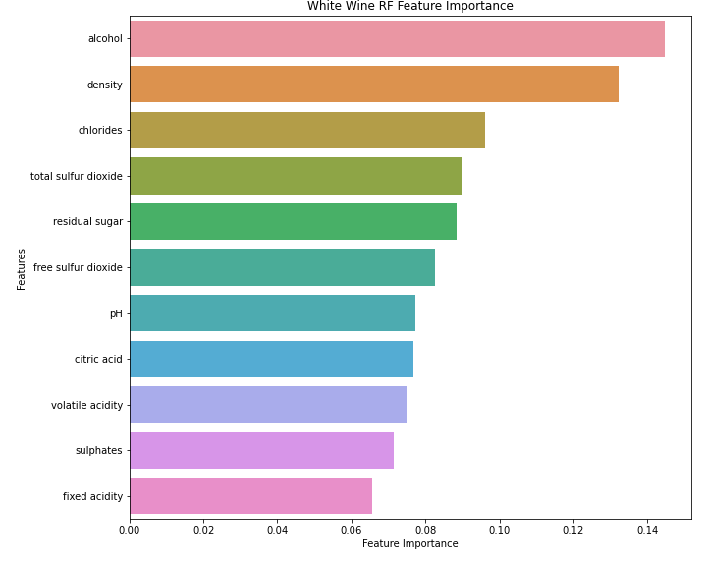

Slide 13

Conclusion
The dataset is made of many duplicates which have been classified as true duplicates and removed prior to modeling
The red wines tend to have lower quality than the white wines
Although each model performed similarly, tree-based models GBT and RF won for both red and white wine
Alcohol was consistently one of the most important features for both datasets

Slide 14
Ideas for Future Research
Apply New Machine Learning Algorithms
More Robust Labeling of Sensory Data
• Neural Nets
• Support Vector Machines
Wine quality pulled from the median of more than 3 tasters, possibly from different regions or from markets with different palettes
Acquired More Features
• Wine Color
• Wine Price
• Wine Name
• Carbonic Acid Levels (carbonation)
• Cask or Bottle Fermented
Focus on Improving Red Wines
White wine had proportionally 30% more high quality wines than the red wine data. Efforts could be directed to improving red wine performance.
Adjust Optimization Metric
Target regression on wine price instead of classification of wine quality

Slide 15

Cheers!

